Slide 1


Team Foretify
April 21, 2022

Slide 2
Current Team Members
Seth Docherty – Data Scientist | GIS – 908.328.7371
Nagaraju Donikena – Machine Learning – 510.456.5125
Wendy Talaro – Resident ISHB Expert | GIS – 310.404.7525
Tridev Raut - GIS Expert - Contact Info – 909.372.6156
Lyle Wright – GIS | Machine Learning – 618.578.5778

Slide 3
Defining the Problem
Where is the need?
The county of Los Angles is looking into the opportunity to understand how to solve many of the challenging problems that many governments face in today's landscape. The county is looking into finding new ways to solve the infestation problem faced by a variety of beetles affecting our trees.
What are the problem(s) you are solving?
Being able to identify locations of infestation with machine learning capabilities in a dynamic way that keeps all stakeholders updated. With dynamic prediction, we can also continue to rerun our model as new verified data enters the system through a variety of avenues.
Who are the different stakeholders?
County decision makers | LA County Cities decision makers

Slide 4
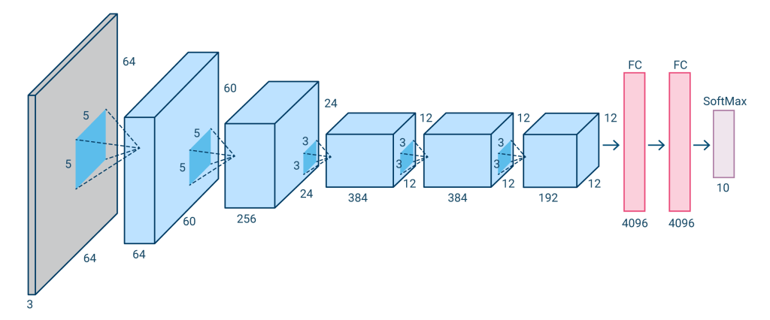



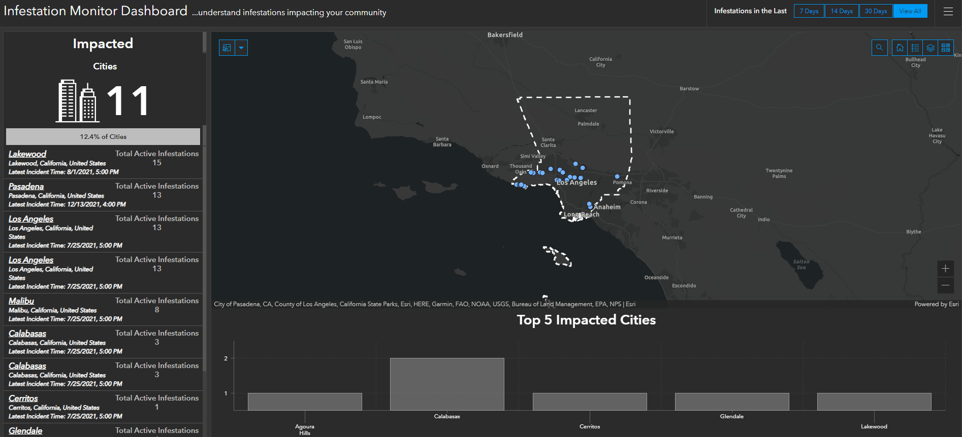
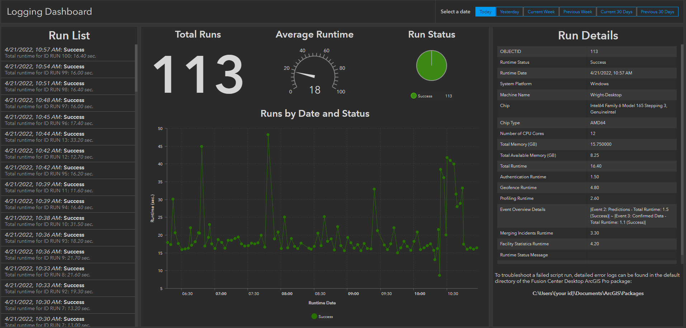
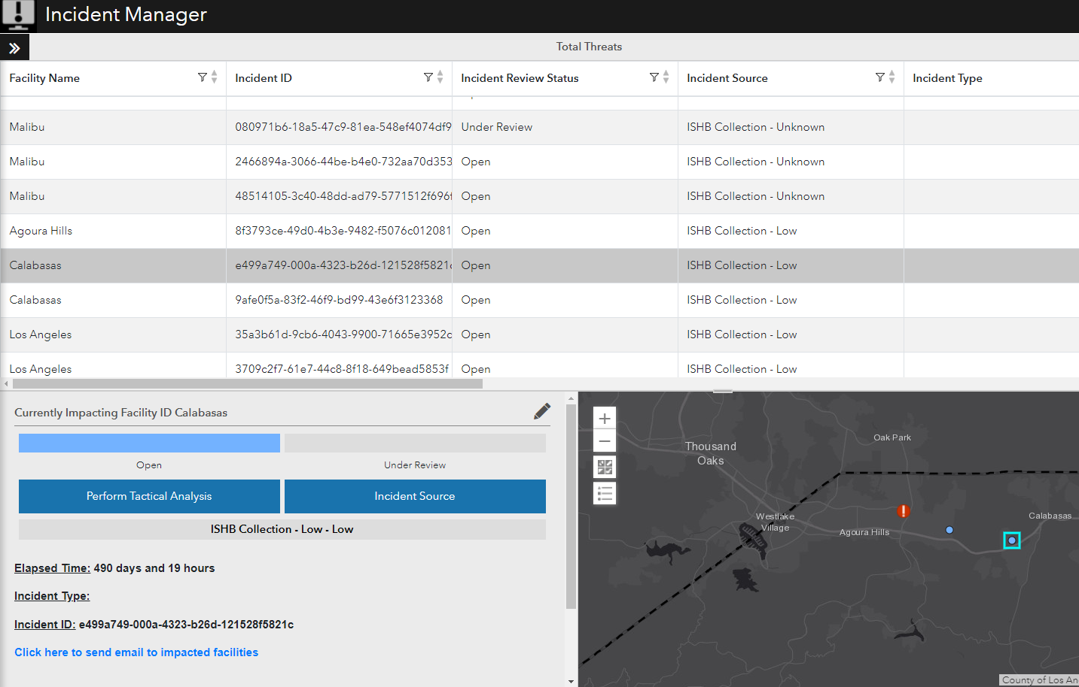
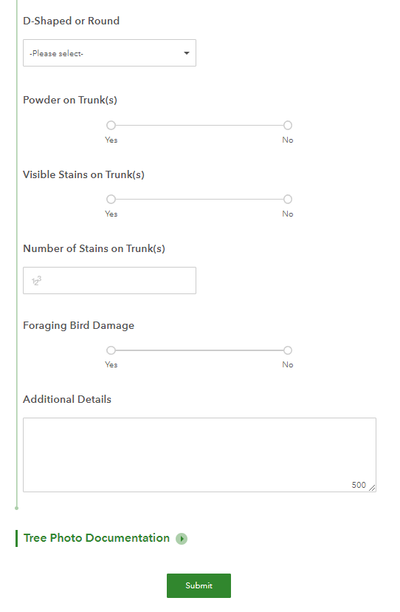
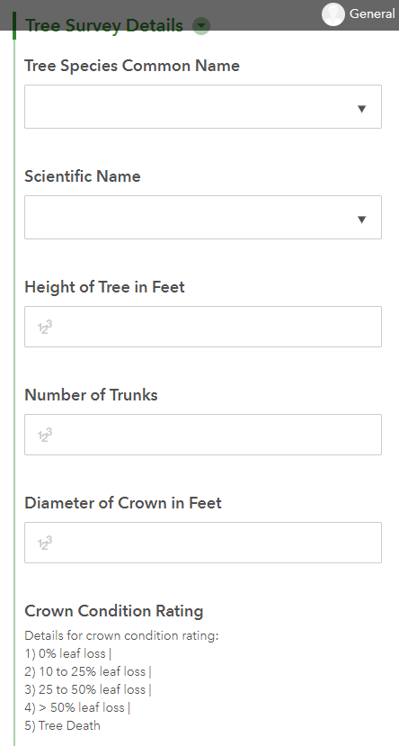
Data Gathering and Workflow
Pull Data from Azure
Pull Data from USGS
Create
Area Grids
1000m
Grid ID for each Grids
Create Geofences for cities
Create Dashboards
Create Clips of all images
Pull Data from LA County
Research on ISHB
Check sizes for clipped images
30 Days
30 Days
Acquiring Data
Prep S.1
Prep S.2
Prep S.3
Create Schema for Surveys
Create Testing Framework
50m
550m
2000m
1000m
Create Predict ML Model
20 epochs
30 epochs
50 epochs
softmax
sigmoid
Create Surveys
Create ML Model
Run Predict ML Model
Pull Newest Landsat
Prep S.1
Prep S.4
Prep S.1
Automated Runs
Prep S.1
Predict P.1
Configure Reporting Layers
Survey 1
Survey 2
Historic Prediction
Fresh Image Prediction
Alerts Dashboard
Logging
Citizens
Professionals
Review Alerts

Slide 5
Application Links
Dashboards
Infestation Monitor Dashboard
Logging Dashboard
Review Application
Surveys
Citizen Scientist Survey
Professional Worker Survey
Surveys
Kill the Bugs

Slide 6
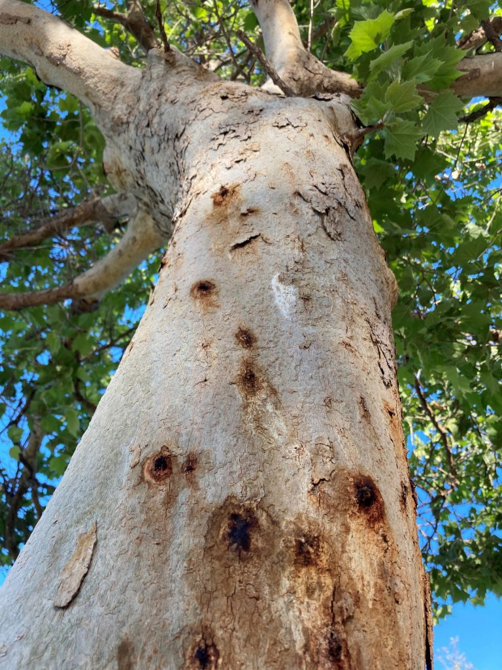
With more time
Improve ML model with other open data on ISHB
Automate Pulling data directly from USGS
Create Update schedule
CV model based on Survey Collection
Auto tree identification from survey
Dispatch Team to areas using Resource Allocation Model
Create Community Marketing (Save the Trees)

Slide 7

Questions
https://www.foretify.ai/

